Slide 1
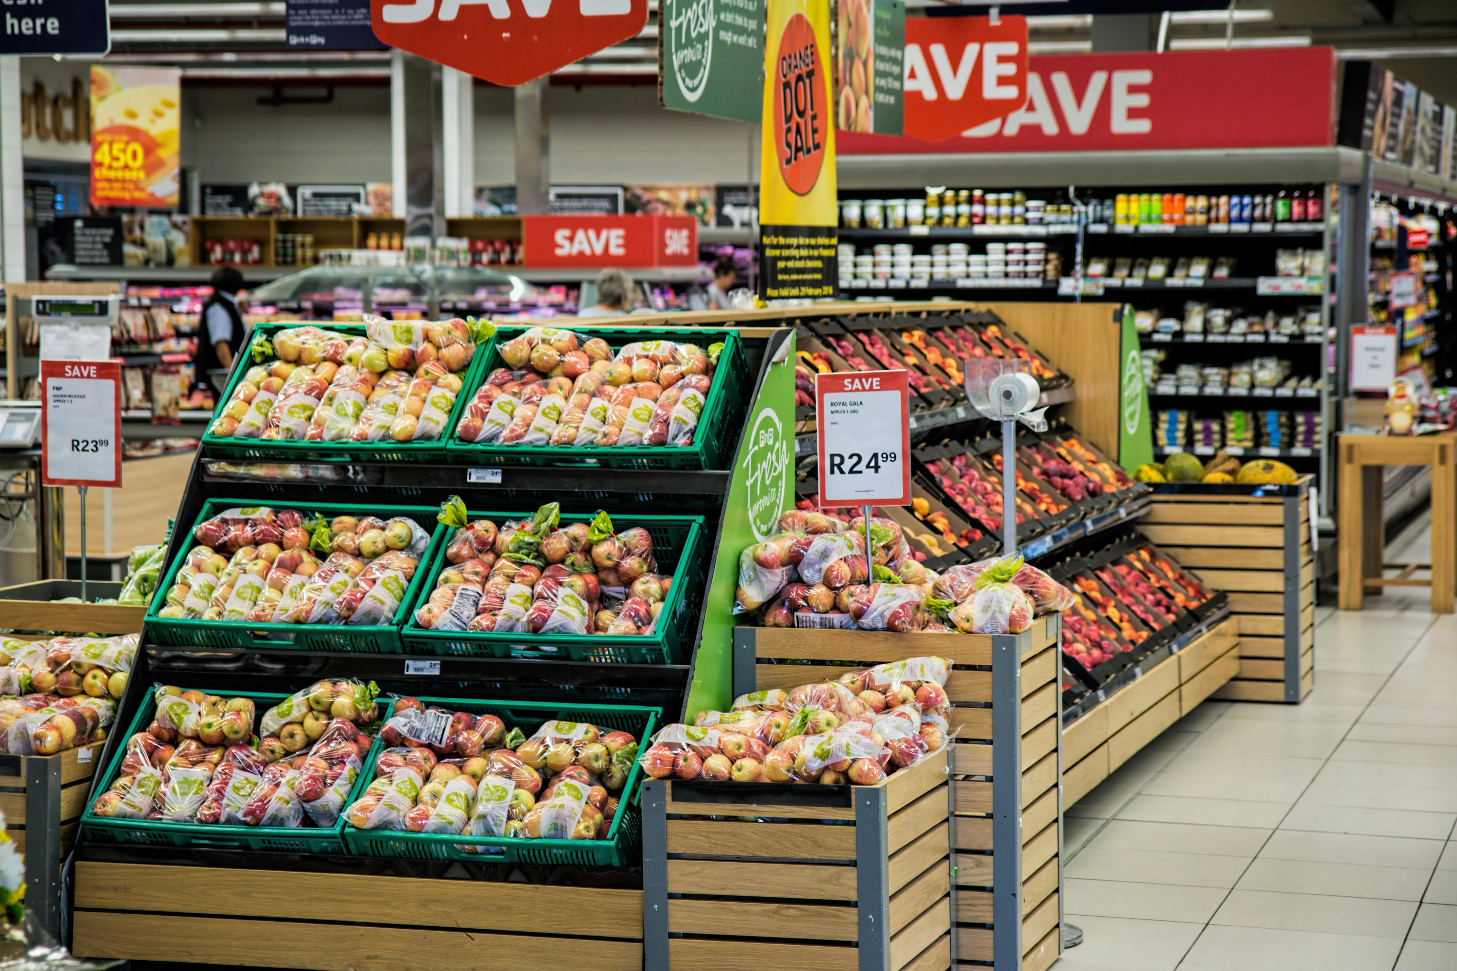
CUSTOMER SEGMENTATION PROJECT BY
OMOGBEME ANGELA CHIDERA ONOH ESTHER MAKANDAH

Slide 2
Agenda
Background
Objectives
Methodology
Executive Summary
Findings
Recommendations
Appendix

Slide 3
BACKGROUND
The project delves into customer segmentation understanding customer behavior and preferences and creating clusters using demographic indicators.
Visualizing centroids to understand their distribution and proximity

Slide 4
INTRODUCTION
The objective of the project is to analyze the provided dataset and identify distinct customer segments based on various demographic and behavioral attributes. By leveraging on K-means clustering

Slide 5
Project analysis slide 4
METHODOLOGY
DATA COLLECTION AND CLEANING
EXPLORATORY DATA ANALYSIS
CHOOSING THE NUMBERS OF CLUSTERS
CHOOSING THE CENTROID
.
VALIDATION

Slide 6
EXPLORATION DATA ANALYSIS

Slide 7
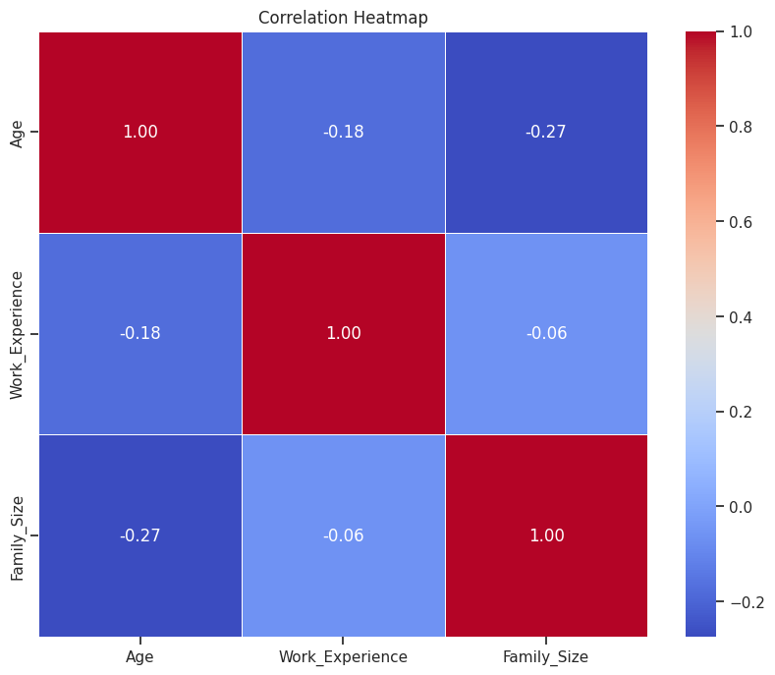

Slide 8
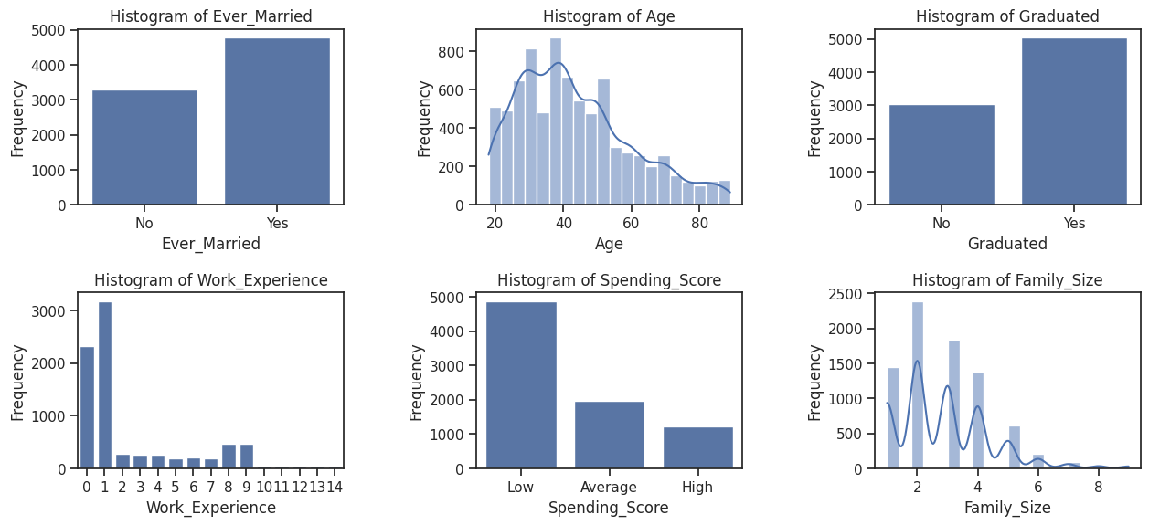

Slide 9
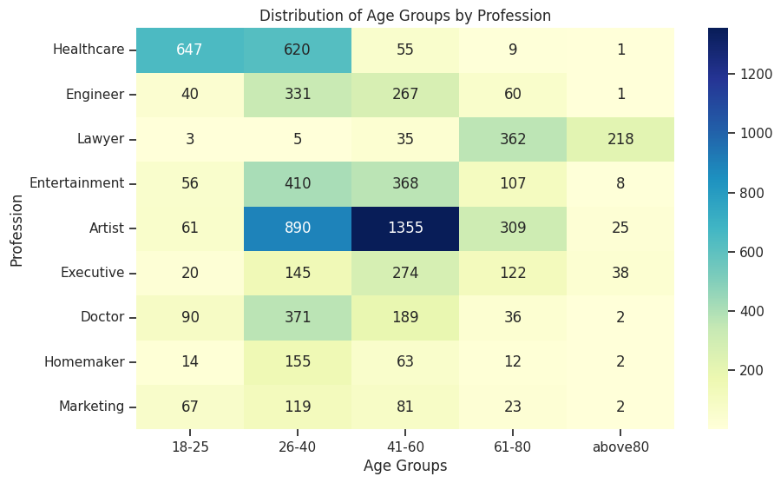

Slide 10
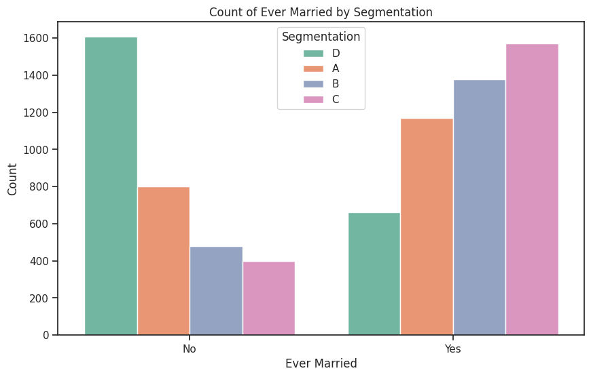

Slide 11
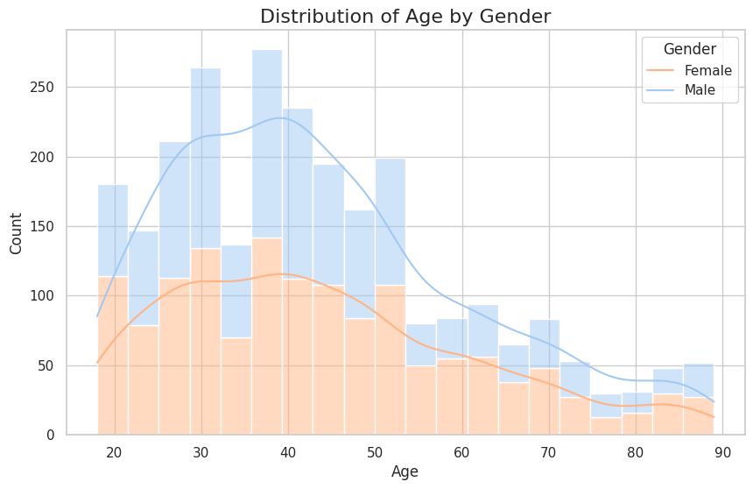

Slide 12
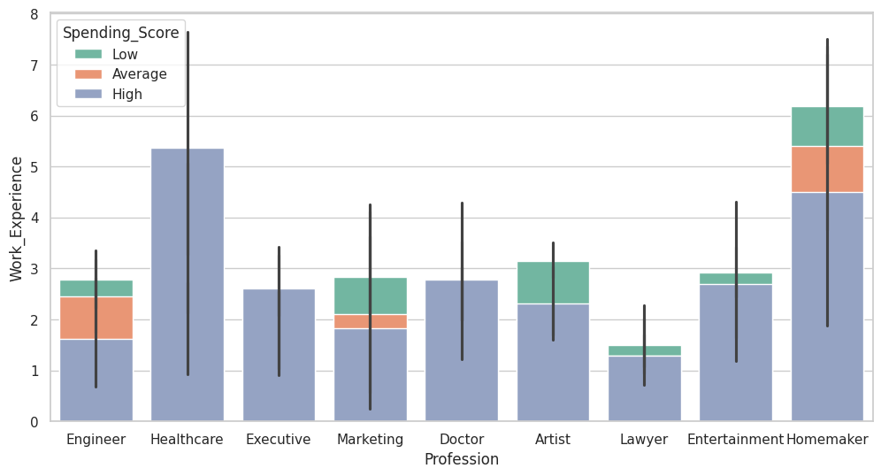

Slide 13
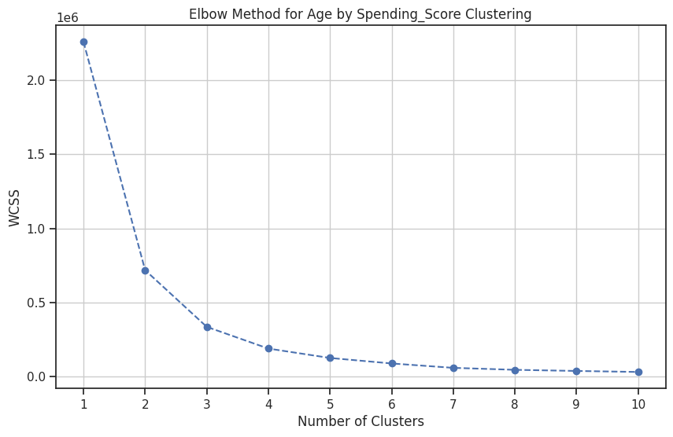
CALCULATING THE NUMBER OF CLUSTERS

Slide 14
FINDINGS
The customers population is mainly segmented by age, marital status, profession, and purchasing power.
The data is segmented into 4 clusters.
Cluster 0: Single people from the arts and entertainment sectors with low purchasing power.
Cluster 1: Middle-aged, married people in the arts sector with average purchasing power.
Cluster 2: Young, single people without higher education and with low purchasing power.
Cluster 3: Older, married people with well-paying jobs and a high purchasing power.
Artists within the age of 41-60 and 26-40 has the highest numbers of customers totalling(2,245) followed by healthcare workers within the ages of 18.25

Slide 15
RECOMMENDATIONS
While individuals in the Artists profession currently represent the largest customer segment, it is imperative to delve deeper into additional factors such as annual income and purchasing power to ascertain their impact on overall profitability. Understanding these variables will provide valuable insights into the potential value added by different customer segments,

Slide 16
LINES OF CODE
# import all the necessary libraries
import pandas as pd
import numpy as np
import matplotlib.pyplot as plt
%matplotlib inline
plt.style.use('ggplot')
import seaborn as sns
import plotly.express as px
# import and read files
test = pd.read_csv(r"/content/drive/MyDrive/Test.csv")
train = pd.read_csv(r"/content/drive/MyDrive/Train.csv")

Slide 17
LINES OF CODE(CTD)
# summary statistical analysis of the test data
test.describe()
# extract the categorical columns from the test data
cat_cols = test.select_dtypes(include = ['object', 'category']).columns.tolist()
cat_cols
# Read the train dataset
train_df = pd.read_csv(r"/content/drive/MyDrive/archive (2)/Train.csv")
# Make a copy of the original DataFrame
train_encoded_df = train_df.copy()
# Define categorical columns for which you want to apply one-hot encoding
categorical_columns = ['Gender', 'Ever_Married', 'Graduated', 'Profession', 'Spending_Score', 'Var_1']

Slide 18
LINES OF CODE(CTD)
# Perform one-hot encoding for each categorical column
for col in categorical_columns:
# Perform one-hot encoding for the column
encoded_df = pd.get_dummies(train_encoded_df[col], prefix=col)
# Concatenate the encoded columns to the copy of the original DataFrame
train_encoded_df = pd.concat([train_encoded_df, encoded_df], axis=1)# Drop the original categorical column
train_encoded_df.drop(columns=[col], inplace=True)
plt.figure(figsize=(15, 10))
features = ['Ever_Married', 'Age', 'Graduated','Work_Experience', 'Spending_Score', 'Family_Size']

Slide 19
LINES OF CODE(CTD)
for i, feature in enumerate(features, start=1):
plt.subplot(3, 3, i)
plt.subplots_adjust(hspace=0.5, wspace=0.5)
if feature == 'Age' or feature == 'Gender' or feature == 'Family_Size':
sns.histplot(df[feature], bins=20, kde=True)
else:A
sns.countplot(data=df, x=feature)
plt.title('Histogram of {}'.format(feature))
plt.xlabel(feature)
plt.ylabel('Frequency')
plt.show()
import matplotlib.pyplot as plt
import seaborn as sns
# Define the age groups
ages = ['18-25', '26-40', '41-60', '61-80', 'above80']
# Count the number of individuals in each age group for each profession
counts = []

Slide 20
LINES OF CODE(CTD)
professions = df['Profession'].unique()
for profession in professions: count_profession = [
len(df[(df.Age >= 18) & (df.Age <= 25) & (df.Profession == profession)]),
len(df[(df.Age >= 26) & (df.Age <= 40) & (df.Profession == profession)]),
len(df[(df.Age >= 41) & (df.Age <= 60) & (df.Profession == profession)]),
len(df[(df.Age >= 61) & (df.Age <= 80) & (df.Profession == profession)]),
len(df[(df.Age > 80) & (df.Profession == profession)]) ]
counts.append(count_profession)
# Plotting
plt.figure(figsize=(10, 6))
sns.heatmap(counts, annot=True, fmt="d", cmap="YlGnBu", xticklabels=ages, yticklabels=professions)
plt.xlabel('Age Groups')
plt.ylabel('Profession')
plt.title('Distribution of Age Groups by Profession')
plt.show()

Slide 21
LINES OF CODE(CTD)
# Map spending score categories to numerical values
spending_score_mapping = {'Low': 0, 'Medium': 1, 'High': 2}
df['Spending_Score_Num'] = df['Spending_Score'].map(spending_score_mapping)
# Selecting the features (Age and Numerical Spending_Score)
X = df[['Age', 'Spending_Score_Num']].values
# Impute missing values with the mean
imputer = SimpleImputer(strategy='mean')
X_imputed = imputer.fit_transform(X)
# Using the Elbow Method to find the optimal number of clusters
wcss = [] # Within-cluster sum of squares
for k in range(1, 11):
kmeans = KMeans(n_clusters=k, init='k-means++', random_state=42)
kmeans.fit(X_imputed)
wcss.append(kmeans.inertia_)

Slide 22
LINES OF CODE(CTD)
# Plotting the Elbow Method graph
plt.figure(figsize=(10, 6))
plt.plot(range(1, 11), wcss, marker='o', linestyle='--')
plt.title('Elbow Method for Age by Spending_Score Clustering')
plt.xlabel('Number of Clusters')
plt.ylabel('WCSS')
plt.xticks(np.arange(1, 11, 1))
plt.grid(True)
plt.show()
Define the optimal number of clusters based on the Elbow Method (e.g., 3 clusters)
n_clusters = 4
# Fit KMeans model
kmeans = KMeans(n_clusters=n_clusters, init='k-means++', random_state=42)
kmeans.fit(X_imputed)
# Assign clusters to the data points
clusters = kmeans.predict(X_imputed)
# Add the cluster labels to the DataFrame
df['Cluster'] = clusters
# Display the first few rows of the DataFrame with cluster labels
print(df.head())

